Slide 1
SSL(Secure Socket layer)/TLS
Netscape
Secure connection between clients and servers essential for Internet’s success
Solution: Encryption and Decryption at a connection’s endpoints
Latest Version is 3.0
SSL sits directly on top of TCP: provides TCP-like interface to upper-layer applications
Supports any application Layer Protocol

Slide 2
Three layer Protocol
SSL Handshake Protocol-allows server and client to authenticate,negotiate encryption algorithm and cryptographic keys
SSL Record Protocol-encapsulation of higher layer protocols
SSL Alert protocol
SSL Change Cipher Spec protocol

Slide 3
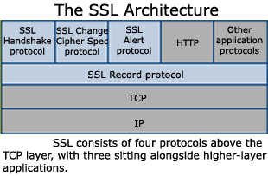
SSL Architecture

Slide 4
Handshake Protocol divided into 4 phases:
Establish Security Capabilities
Server Authentication and key Exchange
Client Authentication and key Exchange
Change CipherSpec and Finish

Slide 5
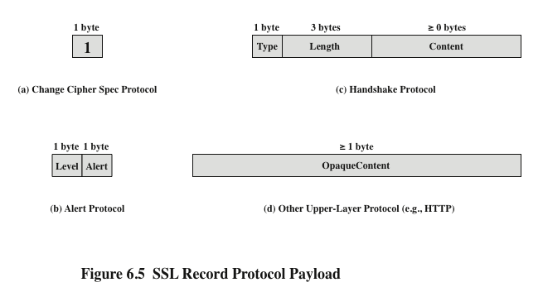

Slide 6
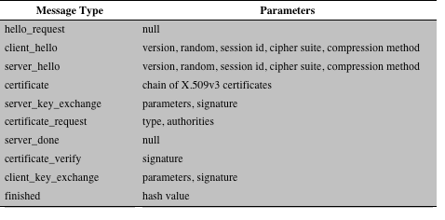

Slide 7
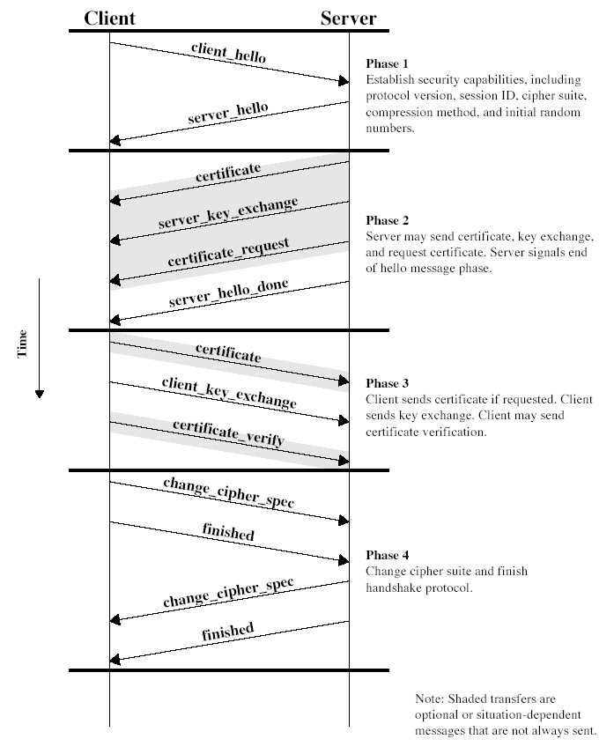

Slide 8
Master_secret=
MD5(Pre_master_secret ||SHA(‘A’||Pre_master_secret || ClientHello.Random || ServerHello.Random)) || MD5(Pre_master_secret ||SHA(‘BB’||Pre_master_secret || ClientHello.Random || ServerHello.Random)) || MD5(Pre_master_secret ||SHA(‘CCC’||Pre_master_secret || ClientHello.Random || ServerHello.Random))

Slide 9
Key_block=
MD5(Master_secret ||SHA(‘A’||Master_secret || ClientHello.Random || ServerHello.Random)) || MD5(Master_secret ||SHA(‘BB’||Master_secret || ClientHello.Random || ServerHello.Random)) || MD5(Master_secret ||SHA(‘CCC’||Master_secret || ClientHello.Random || ServerHello.Random))

Slide 10
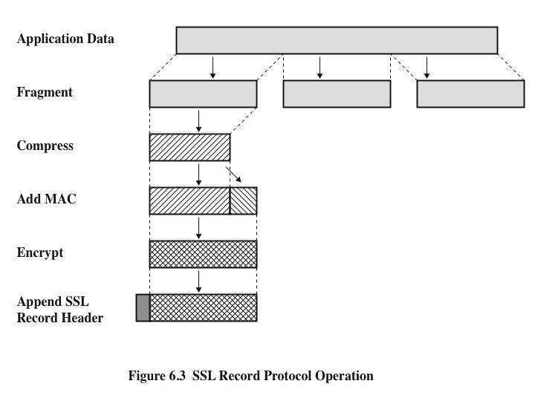

Slide 11
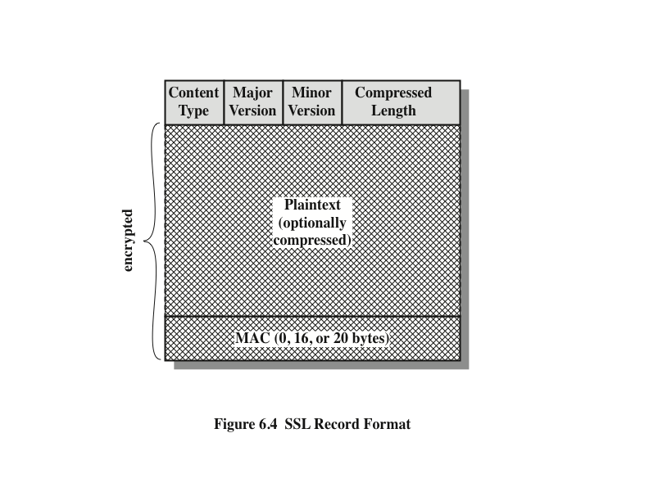
Notes:
The final step of SSL Record Protocol processing is to prepare a header consisting
of the following fields:
• Content Type (8 bits): The higher-layer protocol used to process the enclosed
fragment.
• Major Version (8 bits): Indicates major version of SSL in use. For SSLv3, the
value is 3.
• Minor Version (8 bits): Indicates minor version in use. For SSLv3, the value
is 0.
• Compressed Length (16 bits): The length in bytes of the plaintext fragment
(or compressed fragment if compression is used). The maximum value is
2¹⁴ + 2048.
The content types that have been defined are change_cipher_spec ,
alert , handshake , and application_data . The first three are the SSL-specific
protocols, discussed next. Note that no distinction is made among the various applications
(e.g., HTTP) that might use SSL; the content of the data created by such
applications is opaque to SSL.
Figure 6.4 illustrates the SSL record format.

Slide 12
SSL Alert protocol-Fatal errors
Alert | Description
Bad record MAC | A message is received without a correct MAC
Decompression failure | The decompress function received an improper input
Handshake failure | Sender was unable to negotiate an acceptable set of security parameters from the available option

Slide 13
Non-fatal errors
Alert | Description
No Certificate | Sent in response to certificate request if an appropriate certificate is not available
Bad Certificate | A certificate was corrupt(its digital signature verification failed)
Unsupported certificate | The type of received certificate is not supported
Certificate revoked | The signer of the certificate has revoked it
Certificate expired | The received certificate has expired
Close notify | Notifies that the sender will not send nay more messages in this connection. Each party must send this message before closing its side of the connection

Slide 14
Transport Layer Security(TLS)
Property | SSL | TLS
Version | 3.0 | 1.0
Cipher suite | Supports an algorithm “Fortezza” | Doesn’t support
Cryptography secret | Computed as explained earlier | Uses a Pseudorandom function to create master secret
Alert protocol | As explained earlier | The No certificate alert message is deleted. The following are newly added, Decryption failed,Record overflow,Unknown CA,Decode error,internal error,Export rstriction …
Record protocol | Uses MAC | Uses HMAC

